Slide 1
Archisurance: Scenario 2
Made possible by,
David Loveless
Kevin Li
Alina Rozenbaum
Notes:
My name is Alina Rozenbaum, and here are my partners: David Loveless and Kevin Li. Thank you for meeting with us once more. As the CEO of Archisurance, you are no doubt the most capable person to make the right decision to move this company forward. We would like to show you our thoughts on the direction of Archisurance since the finalization of the merger and incorporation of Bancassurance.

Slide 2

What WAS Archisurance?
Auto
Home
Legal Expenses
Travel
Notes:
Originally Archisurance was three companies that decided to come together as one.
(Legal Expense, Home and Travel, and Auto). For the good of all three they decided to merge.
Before Bancassurance, the Banking and Insurance were done separately,

Slide 3
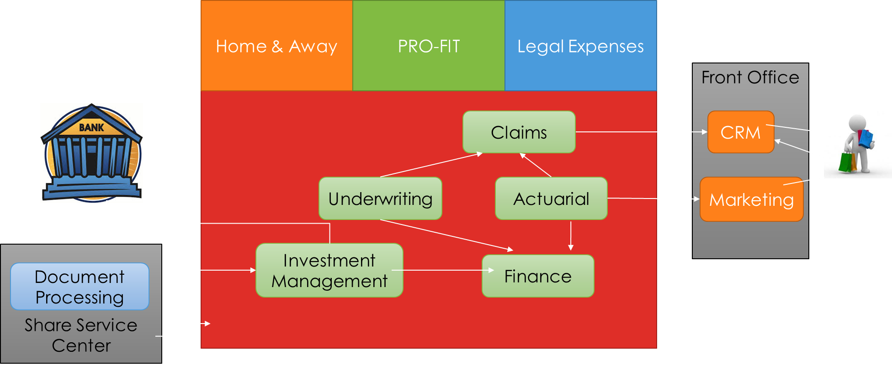
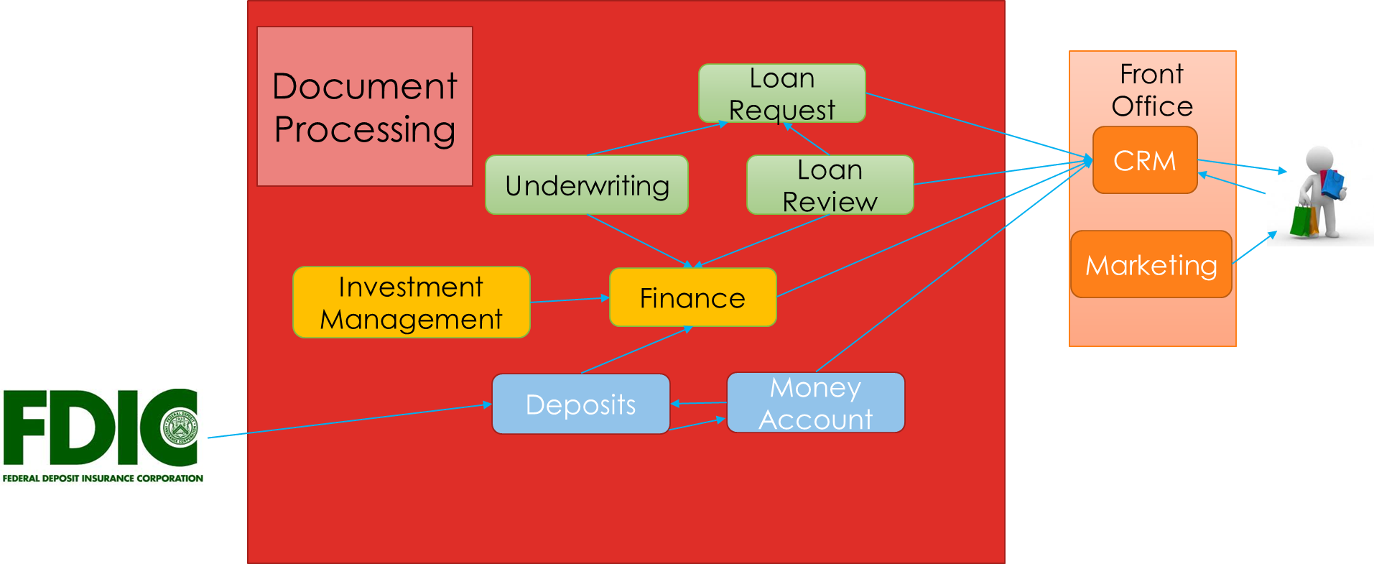
The Separate Components
Insurance
Banking
Notes:
The Insurances and Banking worked as partners, but ti was inconvenient for customers to use both, as their data, accounts, information and services were not linked in any way. This inconvenience led to what is now known as Bancassurance.

Slide 4


Where are we NOW?
Bancassurance
Notes:
You are united.
You are strong.
You are Archisurance.
Together with the bank Archisurance served to adapt to the need of its clientel.

Slide 5
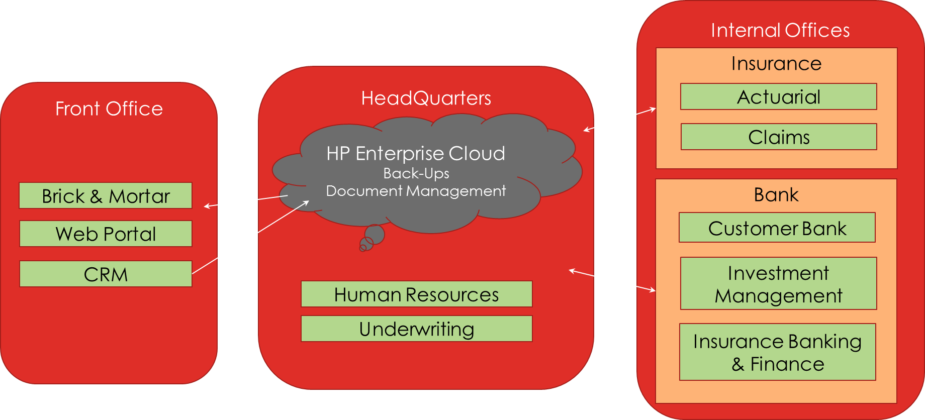
Together as ONE
Notes:
The customer clientele has now merged. Together as one, bancassurance has helped Archisurance serve a happier and larger customer base.
Information is shared, so customers have the convenience and simplicity of getting their banking and insurance needs taken care of in one place.

Slide 6
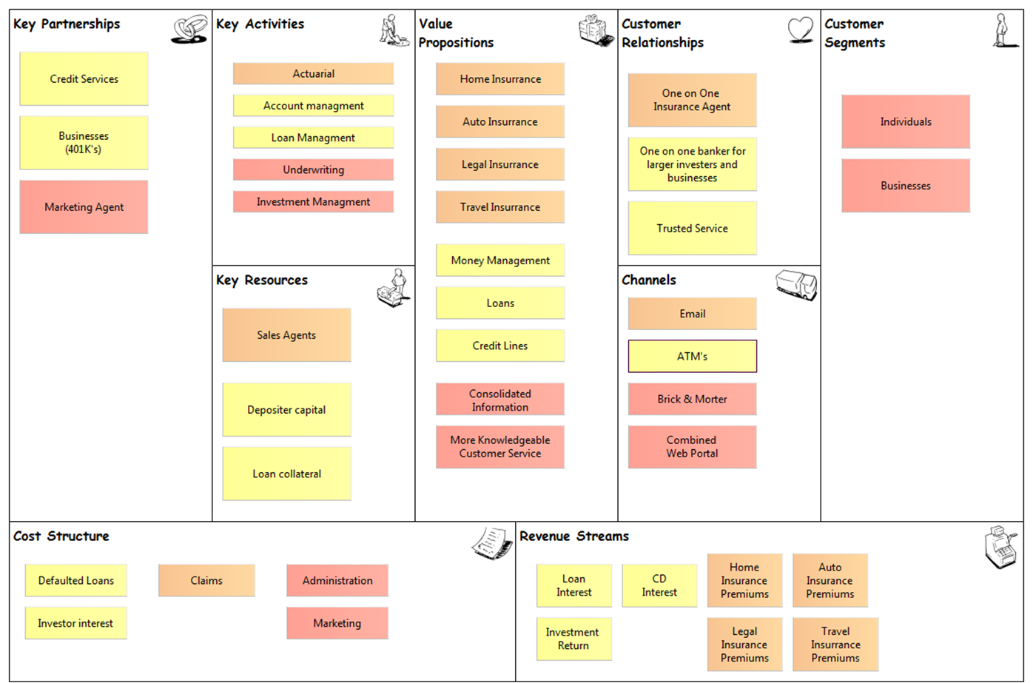
Notes:
It increased the number of channels and the value of the company. Giving more freedom to the individual. And as you may know,
Happy customers equals good business for all. After-all, serving the customers is what Archisurance is all about…and what better way
To make customers happy than ease of access?

Slide 7


Where are we GOING?
Notes:
As we look to the future we can see Archisurance expanding itself. Taking small, but important steps can lead you there.

Slide 8

Involving the CUSTOMER
What are the current problems?
What is our goal?
Where do we change?
How do we change?
Why should we change?
Notes:
Customers like to feel involved in their personal business. They want to know what’s going on, where their money is going and
Be able to change things as they want, on their own terms. Time is money. That is why we feel that you will agree that cutting costs
And focusing on a customer-friendly channel is key to future success. Our goal is to make it so that customers have easier access to
their personal accounts and have an easier time accessing help, with a newly structured web-portal interface. Help the customer feel
More integrated in what this company does. Give them more control over their account, and remove uncessary call-center/CSR phone centers.
Let customers do it themselves. It cuts down expenses and makes everyone happier overall.

Slide 9
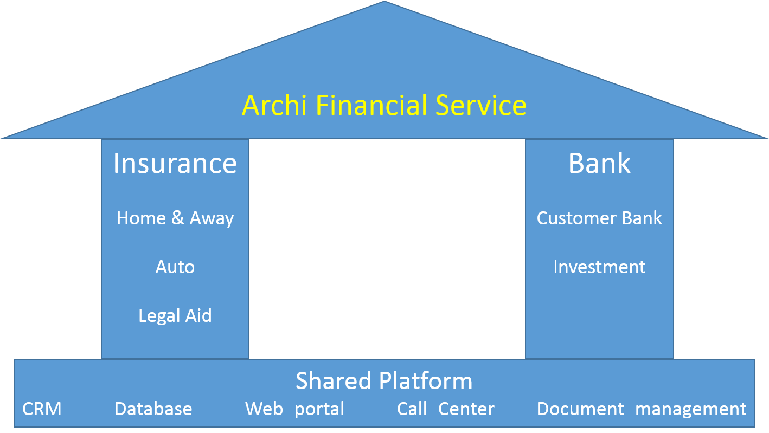
The Structure of the NEW Archisurance
Archisurance
Notes:
Archisurance will be based on this shared platform of database, web, CRM and documentation. The two pillars that are Archisurance will
Be supported by a united system.

Slide 10
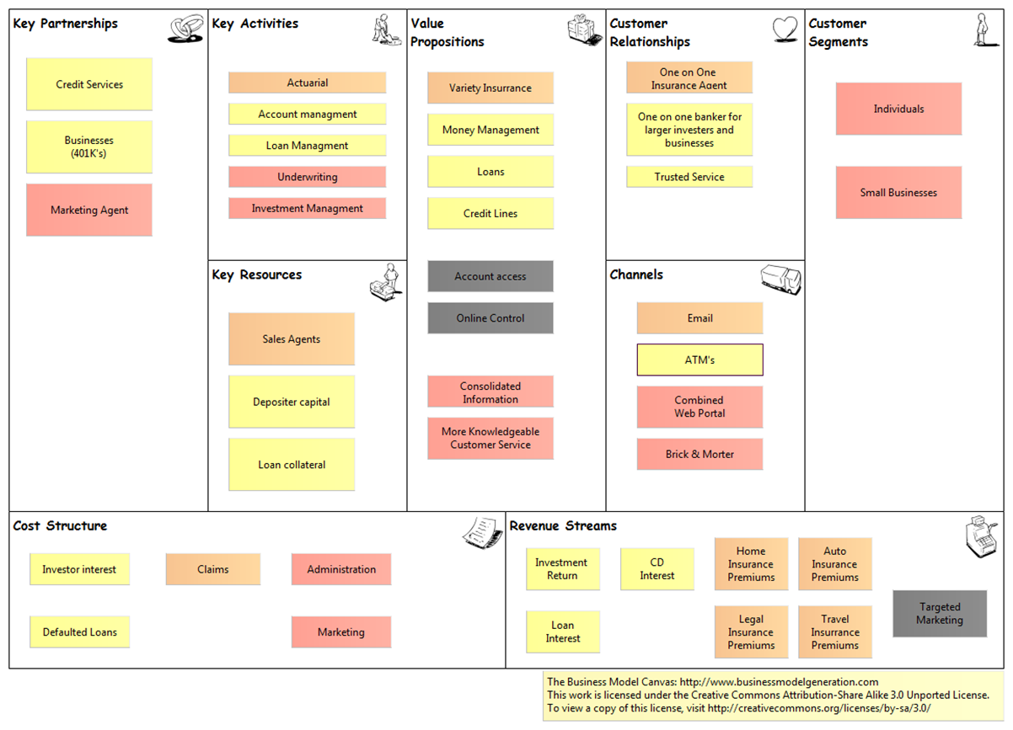

Slide 11

Viewpoints
Organization
Business Process
Application Usage
Notes:
Pictures speak louder than words, so let us visualize how this will play out. How we can cater to the needs of our customers and integrate Archisurance further
To make one, strong united whole.

Slide 12
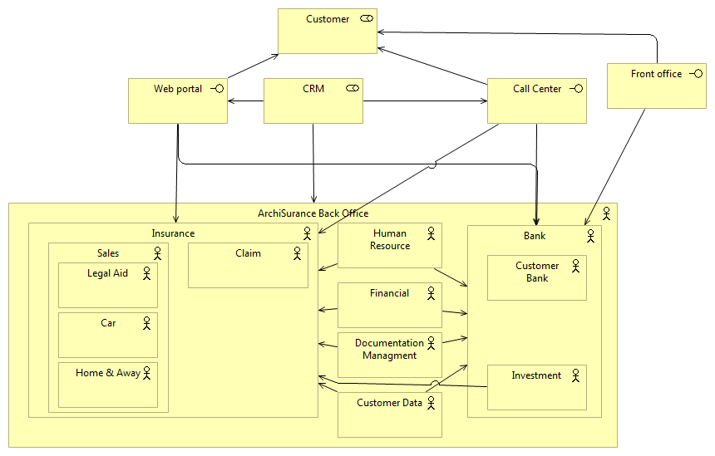
Organization
Notes:
This shows how all the actors interact with the interface along with the separate roles. Here we can see how the web-portal, and more importantly the CRM is now the central point of the schematic. It is where everything connects and goes out from.

Slide 13
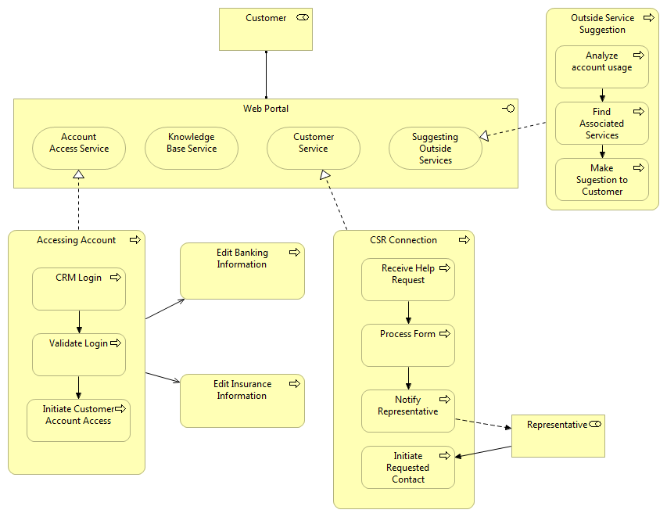
Business Process Condensed
Notes:
In the web-portal (Archisurance website) customers will be able to use and change things in their account. Ask for assistance via any e-mail, chat or phone connection with some of our CSR. Look up questions that have already been answered. And finally Archsiurance can track user history and suggest relevant products based on specific customer needs, boosting the number of products that you sell, to customers that are already looking for those products. Ease of usability is key!

Slide 14
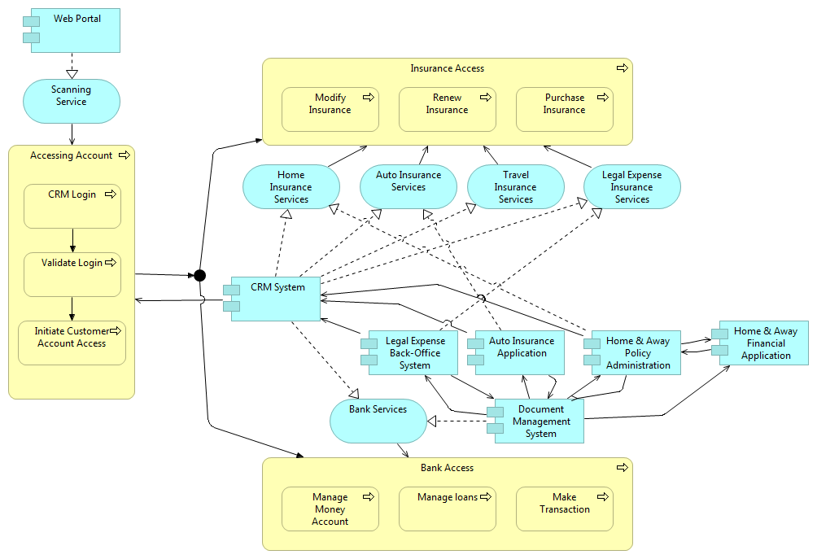
Application Usage Account Access
Notes:
Here we see how the data is transferred from applications, to services and finally to processes to aid our customers in accessing and manipulating the information on their accounts. The CRM is, once-again at the center of all of this, aiding the customer. Everything is uniformly stored in one place.

Slide 15
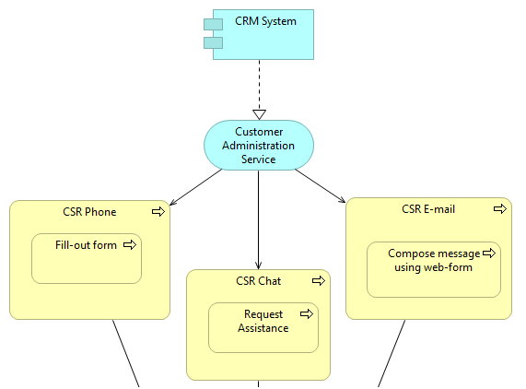
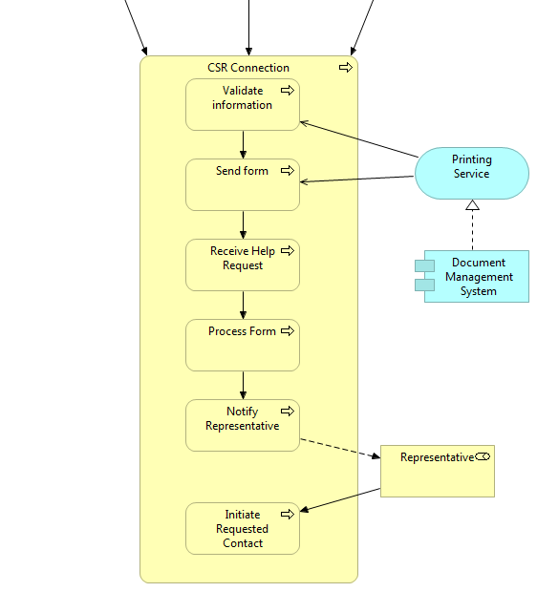
Application Usage
Customer Service Representative
Notes:
Here we also see the various application components and the different ways that a customer can access help.
So they have more options than before on contacting one of your CSR in what-ever manner most suits their needs.
Usability is key. Less frustrated customers is beneficial for long-term partnerships.

Slide 16
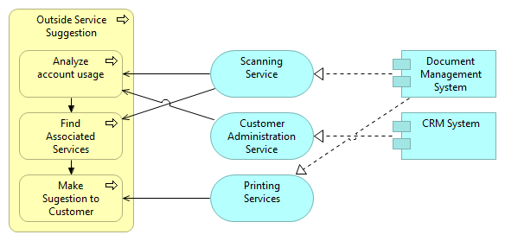
Application Usage – Product Suggestion
Notes:
Finally the suggested services are scanned from user history and patched through to the Document System to compare what the customer is interested in to what products and services the bank and insurance have. Increasing profit for the company as well as customer interest for future endeavors.

Slide 17
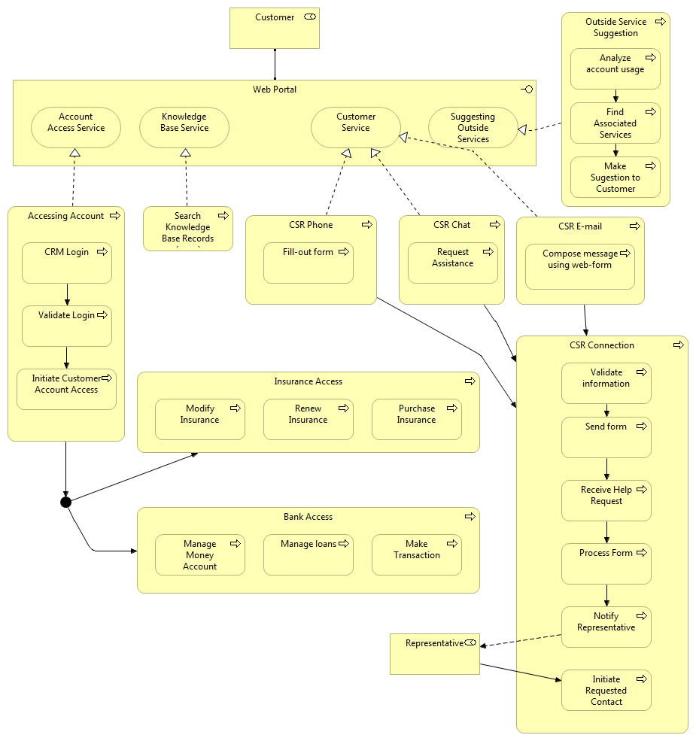
Last Words
Notes:
For references look at the Notes PDF

Slide 18


